Slide 1
Environmental and Pollution Awareness

Slide 2
Environmental Pollution and Its Effects
One of the greatest problems that the world is facing today is that of environmental pollution
Increasing with every passing year and causing grave and irreparable damage to the earth.
Environmental pollution consists of five basic types of pollution, namely, air, water, soil, noise and light.
Some Definitions:
“environment” includes water, air and land and the inter-relationship which exists among and between water, air and land, and human beings, other living creatures, plants, micro-organism and property;
“environmental pollutant” means any solid, liquid or gaseous substance present in such concentration as may be, or tend to be, injurious to environment;
“environmental pollution” means the presence of any environmental pollutant in the environment;

Slide 3
Contd..
“Water pollution” means such contamination of water or such alteration of the physical, chemical or biological properties of water or such discharge of an sewage or trade effluent or of any other liquid, solid or gaseous substance in to water as may render such harmful or injurious to public health or safety .
“Air pollutant” means any solid, liquid or gaseous substance including noise present in the atmosphere in such concentration as may be or tend to be injurious to human beings or other living creatures or environments.
“Air pollution” means the presence of any air pollutant in the atmosphere.
“Light Pollution” means presence of light trespass, over-illumination and astronomical interference.
“Light trespass” means light falling where it is not intended, wanted, or needed. Street lighting, for example, should light streets and sidewalks, not shine into peoples' bedroom windows or illuminate rooftops or tree branches. Also known as spill light, light trespass occurs whenever light shines beyond the intended target and onto adjacent properties.
“Over illumination” means sensation produced by luminance within the visual field that is sufficiently greater than the luminance to which the eyes are adapted to.

Slide 4
Classification of pollution:
Pollution
By Activity By the object which is polluted
Natural pollution Artificial pollution Air pollution
depending upon human Water pollution
Earthquakes activity and industrial Food pollution
Flood operation Noise pollution
Draught Land pollution
Cyclone

Slide 5
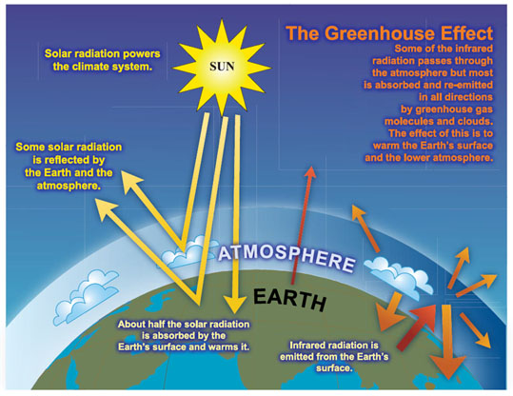
Greenhouse Effect

Slide 6
Greenhouse Effect
A greenhouse gas (sometimes abbreviated GHG) is a gas in an atmosphere that absorbs and emits radiation within the thermal infrared range. This process is the fundamental cause of the greenhouse effect. The primary greenhouse gases in Earth's atmosphere are water vapor, carbon dioxide, methane, nitrous oxide, and ozone. Without greenhouse gases, the average temperature of Earth's surface would be about 15 °C (27 °F) colder than the present average. In the Solar System, the atmospheres of Venus, Mars and Titan also contain gases that cause a greenhouse effect.
Without these gases, the heat would not reflect back and increase the temperature of the atmosphere.
These gases are commonly known as Greenhouse gases, because they help to maintain the Earth’s average temperature.
Simply put, it is a natural process which make the Earth’s atmosphere just right for life forms to flourish.

Slide 7
Global Warming On The Rise
Global warming is rapidly increased by rising up the temperature of earth's atmosphere and level of oceans in the past few years.
The negative effects of Global warming are heat waves, unusual warm weather, ocean warming, rise in sea level, and coastal flooding, warming of Arctic and Antarctic zones, changes in the pattern and amount of precipitation.
Species extinction and melting of the glaciers which have proven to be extremely dangerous.

Slide 8
Pollution and Global Warming

Slide 9
In the decade of seventy, for the first time the attention of the world was drawn towards the environment. In the year 1972 under the auspices of U.N.O. a conference was held at Stockholm known as Stockholm conference on Environment and Developmant-1972. Government of India participated in the conference and strongly voiced the environment concerns. Mrs.Indira Gandhi, THE PRIME MINISTER of India, declared a remarkable environmental policy for India. With the increasing industrialization the problem of air pollution has began to be felt in the country. The presence in air, beyond certain limits of various pollutants discharged through emission and from certain human activities concerned with traffic, heating use of domestic fuel, refuse, incinerations etc. has a harmful effect on the health of the people. Indians realized that the haphazard industrialization and unplanned development had resulted pollution of air, water and the exhaustion of the irreparable natural wealth.
HISTORY:

Slide 10
Environmental legislation are as follows: 1.The Indian Forests Act,1972 2. The Atomic Energy Act,1962 3. The Factories Act,1948 4. The Insecticides Act,1968 5. The wild life (protection) Act,1972 6. The Water (Prevention and Control of Pollution)Act,1974,1977 7. The Forest (Conservation)Act,1980 8. The Air (Prevention and Control of Pollution)Act,1981 9. The Environment(protection) Act,1986 10. The Motor Vehicles Act,1988 11. The National Environmental Tribunal Act,1995

Slide 11
Green IT
“Green IT is a collection of strategic and tactical initiatives that directly reduces the carbon footprint of an organisation’s computing operation… However, Green IT is not just focused on reducing the impact of the ICT industry. It is also focused on using the services of ICT to help reduce the organisation’s overall carbon footprint.”
Also called green computing it describes the study and the using of computer resources in an efficient way.
Green IT starts with manufacturers producing environmentally friendly products and encouraging IT departments to consider more friendly options like virtualization, power management and proper recycling habits.
The government has also recently proposed new compliance regulations which would work towards certifying data centres as green.
Some criteria includes using low-emission building materials, recycling, using alternative energy technologies, and other green technologies.

Slide 12
Green Computing
Why
computer energy is often wasteful
leaving the computer on when not in use (CPU and fan consume power, screen savers consume power)
printing is often wasteful
how many of you print out your emails or meeting agendas
printing out partial drafts
for a “paperless” society, today we tend to use more papers than before computer era.
pollution
manufacturing techniques (use of automated systems)
packaging
disposal of computers and components
toxicity
as we will see, there are toxic chemicals used in the manufacturing of computers and components which can enter the food chain and water!

Slide 13
Energy Use of PCs
CPU uses 120 Watts
CRT uses 150 Watts
8 hours of usage, 5 days a week = 562 KWatts
if the computer is left on all the time without proper power saver modes, this can lead to 1,600 KWatts
for a large institution, say a university of 40,000 students and faculty, the power bill for just computers can come to $2 million / year
Energy use comes from
electrical current to run the CPU, motherboard, memory
running the fan and spinning the disk(s)
monitor (CRTs consume more power than any other computer component)
printers

Slide 14

Reducing Energy Consumption
Turn off the computer when not in use, even if just for an hour
Turn off the monitor when not in use (as opposed to running a screen saver)
Use power saver mode
in power saver mode, the top item is not necessary, but screen savers use as much electricity as any normal processing, and the screen saver is not necessary on a flat panel display
Use hardware/software with the Energy Star label
Energy Star is a “seal of approval” by the Energy Star organization of the government (the EPA)
Don’t print unless necessary and you are ready
Use LCDs instead of CRTs as they are more power efficient

Slide 15
Other Solutions
Reuse: donate your computer components to people who may not have or have lesser quality computers
inner city schools, churches, libraries, third world countries
this however leads to the older computers being dumped but there is probably no way around this as eventually the older computers would be discarded anyway
Refurbish: rather than discarding your computer when the next generation is released, just get a new CPU and memory chips – upgrade rather than replace
while you will still be discarded some components, you will retain most of the computer system (e.g., monitor, the system unit housing, cables)
Are there adequate incentives to do either of the above? Do computer companies encourage refurbishing/upgrading?

Slide 16
One More Solution: Recycling
If companies can recycle the plastics and other components, this can greatly reduce waste and toxins
however, the hazardous materials in e-waste can harm the recycle workers if they are not properly protected
in undeveloped countries, a lot of the recycling chores are left up to unprotected children!
Developed countries now have facilities for recycling e-waste
however, in Europe, the plastics are discarded instead of recycled because the flame retardant chemicals are too toxic to work with
To resolve these problems, the computer manufacturers must start using recyclable chemicals

Slide 17

Concept of Carbon Credit
Birth of Carbon Credit
Growth of Carbon Credit
India’s Position

Slide 18
Carbon Credit
“A certificate showing that a government or company has paid to have a certain amount of carbon dioxide removed from the environment”.
Or “A carbon credit is a generic term for any tradable certificate or permit representing the right to emit one tonne of carbon dioxide or the mass of another green house gas equivalent to one tonne of carbon. ”
A tradable credit can be an emissions allowance or an assigned amount unit which was originally allocated or auctioned by the national administrators of a Kyoto-compliant cap-and-trade scheme, or it can be an offset of emissions.
The goal is to allow market mechanisms to drive industrial and commercial processes in the direction of low emissions or less carbon intensive approaches than those used when there is no cost to emitting carbon dioxide and other GHGs into the atmosphere. Since GHG mitigation projects generate credits, this approach can be used to finance carbon reduction schemes between trading partners and around the world.
Carbon credits differ from carbon allowances although the term carbon credit is interchangeably used to represent both.

Slide 19
Carbon Footprint
A carbon footprint is historically defined as "the total sets of greenhouse gas emissions caused by an organization, event, product or individual.”
A measure of the total amount of carbon dioxide (CO₂) and methane (CH₄) emissions of a defined population, system or activity, considering all relevant sources, sinks and storage within the spatial and temporal boundary of the population, system or activity of interest. it is often expressed in terms of the amount of carbon dioxide, or its equivalent of other GHGs, emitted.
Greenhouse gases (GHGs) can be emitted through transport, land clearance, and the production and consumption of food, fuels, manufactured goods, materials, wood, roads, buildings, and services.
An individual's, nation's, or organization's carbon footprint can be measured by undertaking a GHG emissions assessment or other calculative activities denoted as carbon accounting. Once the size of a carbon footprint is known, a strategy can be devised to reduce it, e.g. by technological developments, better process and product management, changed in Green Public or Private Procurement, etc.

Slide 20
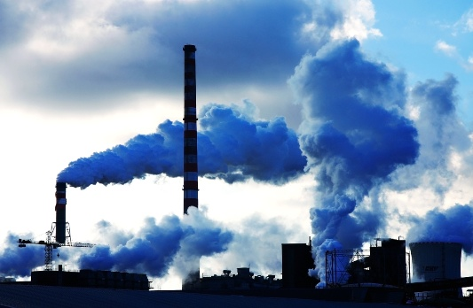
Emission Trading
Payment for CC
Developed country A
(needs CC)
Developed country B
Earns carbon credits called
Assigned Amount Units
Sell these carbon credits

Slide 21

What should be the price of carbon????
The price of the carbon credits is set by the principles of demand and supply.
The government slowly reduces the number of carbon credits in the market, increasing their prices and making it more feasible to reduce GHG’s than to buy carbon credits.

Slide 22




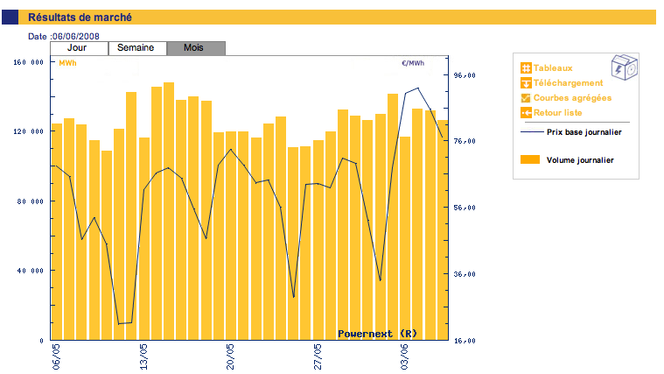
Market for Carbon Trading……
Currently in international market, Environmental Exchanges, trading in Carbon Credits are
EUROPEAN CLIMATE
EXCHANGE
POWER NEXT

Slide 23
India’s Contribution to Carbon Credits
India’s contribution to carbon credits stands at $1 billion, out of a global trading of about $5 billion. India has generated about 30 million carbon credits and has a line-up of about 140 million to introduce into the global market.
These comprise chemical units, plantation companies, municipal corporations and waste disposal units that can easily sell their carbon credits for good amounts of money.
Such as, Adani Power managed to reduce GHG emissions by 1.8 million CERS in the Mundra Project in Gujarat. So it sold the excess carbon credits, getting about 600 crores from the transaction.

Slide 24
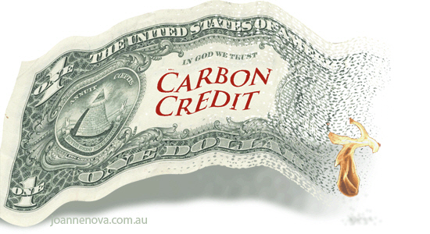

India pocketed Rs 1,500 crores in the year 2005 just by selling carbon credits to developed- country clients.
India has generated 30 million
Carbon credits & 140 million
are in pipeline

Slide 25

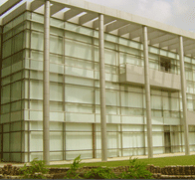

Some of the Leading companies of India using & selling Carbon Credits…
GUJARAT FLOUROCARBONS Ltd.

